Slide 1
Introduction To PostSharp
Eric Liprandi

Slide 2
About Me
Software Engineer at Schneider Electric
@EricLiprandi
http://blog.liprandi.net

Slide 3
Agenda
What is AOP?
PostSharp OOTB
Extend PostSharp

Slide 4
What is AOP?
Aspect Oriented Programming
Aspect
Stand-alone, cross-cutting module
Advice
function that actually does the work

Slide 5
AOP In C#
Attributes
Polymorphism
“Manual wrapping”

Slide 6
You are already doing it!
ASP.NET MVC
DI/IoC
Interception

Slide 7
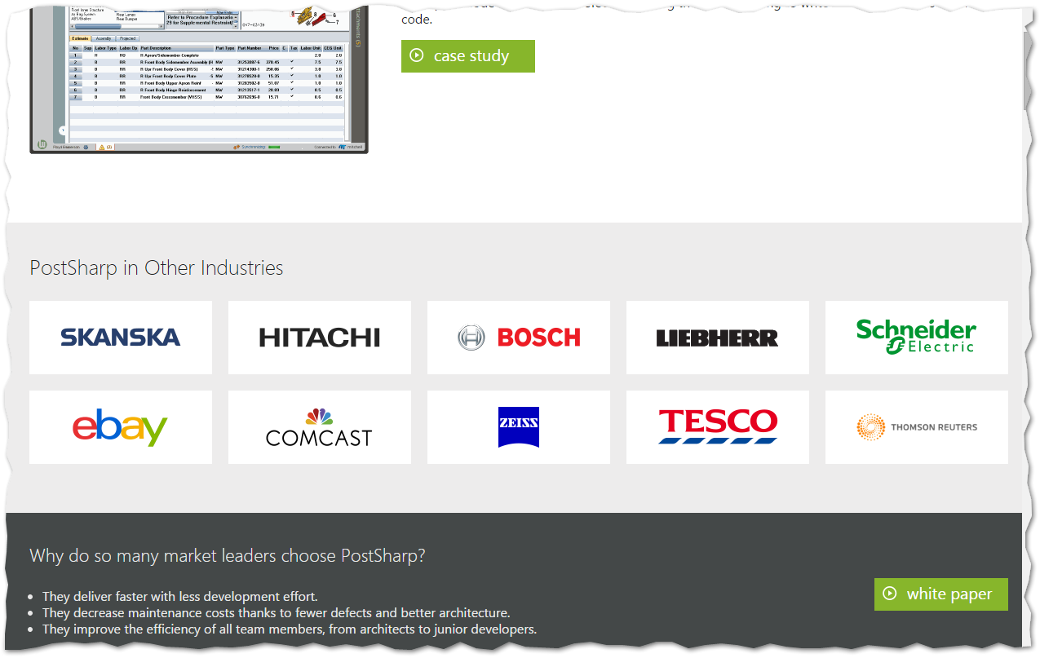
PostSharp
Easy integration with Visual Studio
Current
V4.1
Support VS 2015, 2013, 2012
Large customer base*

Slide 8
Demo
Getting started

Slide 9
Getting Started
Install PostSharp
Use NuGet to Add PostSharp
References
Build Tasks
Add Aspect(s)
Compile/Execute

Slide 10
Demo
dotPeek

Slide 11
What’s going on?
IL Weaving
Compile-Time
Runtime
Executes custom code

Slide 12
Demo
Multicasting

Slide 13
Bulk Assignment (Multicasting)
To all members of a class
Apply attribute to class
AssemblyInfo.cs
Use [assembly:]
Apply to entire namespaces
Exclude type or types using priority and exclude
Use class visibility
Use method modifier

Slide 14
Other OOTB patterns
Standard
Logging
Undo/Redo
Contracts
Parent/Child Relationships
Threading
Thread-safe
Dispatch to Background/UI

Slide 15
Demo
Build our own

Slide 16
Building your own
{
OnEntry();
try {
// actual method call
OnSuccess();
} catch() {
OnException();
} finally {
OnExit();
}
}
OnMethodBoundaryAspect
Try/Catch/Finally
Access to:
Arguments
Return Value
Flow
Exception

Slide 17
Demo
Compile Time

Slide 18
Compile Time
Validate Location
Access to Metadata
“Cache” information
Reflection-type
[Serializable]

Slide 19
Why use PostSharp
Clutter-free
Thread-safety
Typo-safe

Slide 20
But…
PostSharp won’t solve all your problems!
Good architecture = easy to integrate
It’s not free

Slide 21
Takeaways
Simple to add great value OOTB
Great Flexibility in assigning aspects
BYOA (Build Your Own Aspects)

Slide 22
Resources
www.PostSharp.net
www.Pluralsight.com
AOP in .NET (http://bit.ly/1CNSc7t)
PostSharp Fundamentals (http://bit.ly/1C8xI71)

